Slide 1
IMS Project
By Adigwe (Adi) Uraih

Slide 2
Introduction
Name: Adigwe Uraih
How I approached the specification:
Created my risk log, Jira board and ERD
Once I was able to start the code, I wrote down all the relevant tasks that I needed to do
Planned how and when I should I complete individual tasks, while leave time for contingencies just in case the project was delayed

Slide 3
Consultant journey
Technologies learnt:
Git
Github
Jira
MySQL (Both MySQL Workbench and SQL on Google Cloud Platform)
Java Programming language
Eclipse
Maven
JUnit

Slide 4
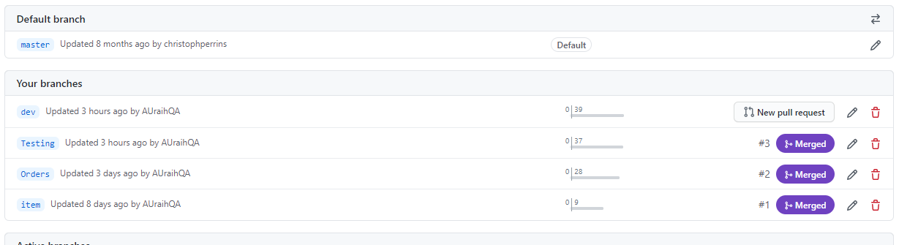
Version control
Branches:
Master
Dev
Orders
Item
Testing
The branches where I worked on the features were Items, Orders and Testing.

Slide 5
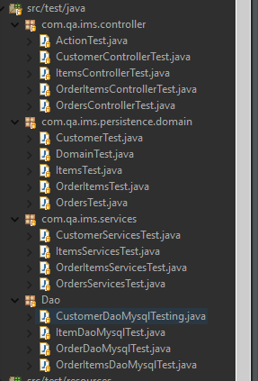
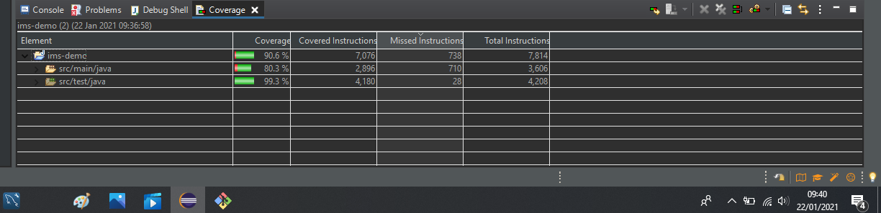
Testing

Slide 6
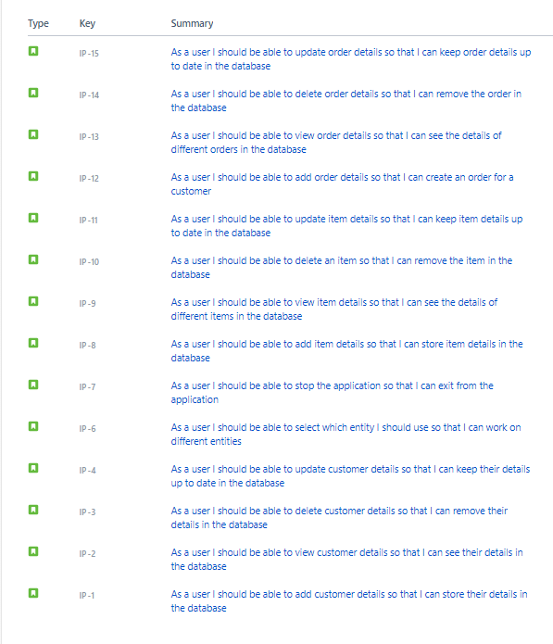
User stories

Slide 7
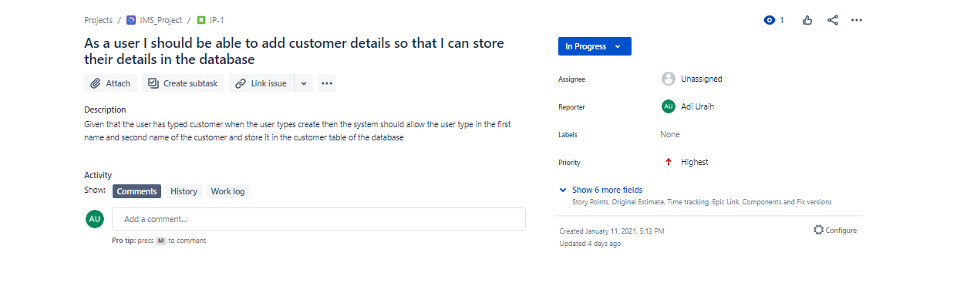
Example of acceptance criteria

Slide 8
SPRINT REVIEW
I was able to complete each user story that
No user story was left out in order to complete CRUD
All must have user stories were completed

Slide 9
SPRINT RETROSPECTIVE
What went well?
All user stories were completed
80% of code was covered
What could be improved?
Time left to put everything together
Amount of time given from when I started the project
Not having all user stories as must haves
Being able to create, read, update and delete without the system restarting all over

Slide 10
Conclusion
Expanded my knowledge on a wide range of technologies
Was able to know where I am at regarding what has been taught
Now know that tasks take longer than expected
Give more time certain tasks such as testing
Adding more risks to risk log

